Slide 1

#HackYourData...Qual
Jack Taylor & Stephanie Allan
@JackEdTaylor & @eolasinntinn

Slide 2
Aims of this Session
Introduce tidytext
Applying some of what we have learned for working with text data
Build a wordcloud.
Learn more about R as a qualitative data visualisation tool.
Notes:
Again. Being faced with messy data can be overwhelming and you may be asking yourself questions like:
* How can I organise this data?
* How can I make this data meaningful?
* How can I make this data TIDY?
* Why should I bother?
Some have estimated that 80% of data analysis is actually spent on data preparation (Dasu & Johnson, 2003), getting your data into a usable format before you even think about analysing it. Many people spend days, weeks, and even months labouring over data cleaning in Excel which involves numerous point and click repetitions. This isn't only stressful for you as a researcher, but it's an inefficient use of time and resources which could in turn impact on your own productivity but also the productivity of your lab or research group.
The way to get over this hurdle is through developing skills in **DATA WRANGLING**.
One of the amazing things about R being open source and available to all is that **ANYONE** can write code, functions, and packages and make them freely available to all.
That's great news for us because this crowdsourcing approach to coding has given us the Tidyverse

Slide 3
Notes:
In an ideal world, we would conduct our research, collect our data - whether that be quantitative or qualitative - and then analyse our data using R as our tool.

Slide 4
Data Viz – questions to ask:
How can I make text meaningful?
How can I organise this text?
How can I make text tidy?
Notes:
Again. Being faced with messy data can be overwhelming and you may be asking yourself questions like:
* How can I organise this data?
* How can I make this data meaningful?
* How can I make this data TIDY?
* Why should I bother?
Some have estimated that 80% of data analysis is actually spent on data preparation (Dasu & Johnson, 2003), getting your data into a usable format before you even think about analysing it. Many people spend days, weeks, and even months labouring over data cleaning in Excel which involves numerous point and click repetitions. This isn't only stressful for you as a researcher, but it's an inefficient use of time and resources which could in turn impact on your own productivity but also the productivity of your lab or research group.
The way to get over this hurdle is through developing skills in **DATA WRANGLING**.
One of the amazing things about R being open source and available to all is that **ANYONE** can write code, functions, and packages and make them freely available to all.
That's great news for us because this crowdsourcing approach to coding has given us the Tidyverse

Slide 5
Tidy Text
Data is in a table
One ‘token’ (usually a word) per row
Notes:
Tidytext is a specific R package set up to make dealing with text easier. We will cover some absolute basics of the package but whole book is free to access online.
One of the key underlying structures of the tidyverse is that data structures follow a tidy format:
1. Each variable is in a column
2. Each observation is a row
3. Each value is a cell
If you make sure your data is tidy, you'll spend less time rummaging through rubbish on your research path and spend more time working on your all important analysis!

Slide 6
Prepare Data
Pipe Data into Plot
Build Plot
Add Plot Features
Notes:
As we can see, ggwordcloud builds upon what we have already learned using ggplot 2 in terms of syntax.

Slide 7
Notes:
Through using powerful tools within the Tidyverse and Tidytext we have been able to tidy our messy dataset using found wikipedia material in order to create a clear, accessible visualisation which provides us with interesting information about our data. Data cleaning doesn’t have to be time consuming and stressful - with the right tools, you are more than capable of hacking your data tidy which has a range of benefits for your productivity, your stress levels, and your ability to communicate your research clearly and effectively.

Slide 8
If you get stuck / want to try something new.
Notes:
As you know by now, googling when you get stuck is an essential part of coding. As postgraduate students we are all used to research and this is no different.

Slide 9
Take a math plot, and make it letter(s)

Slide 10
Creating Qual Diagrams
DiagrammeR allows us to chart relationships (edges) between nodes (themes).
Code (and data) means that qualitative visualizations are fully reproducible.

Slide 11

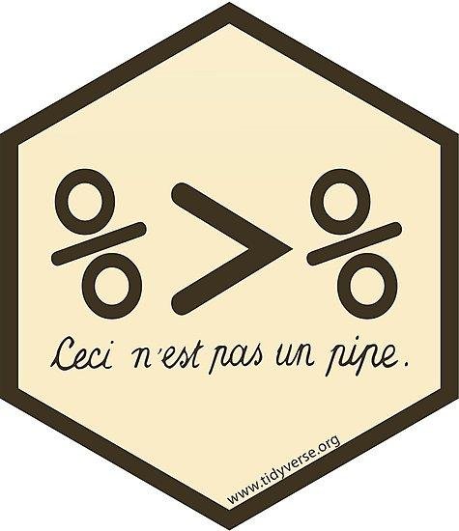
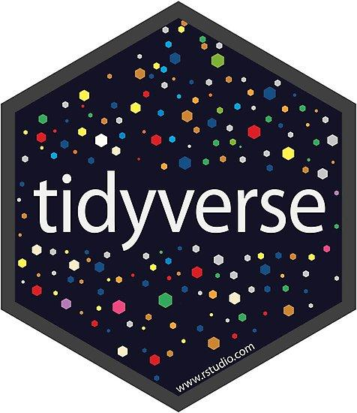
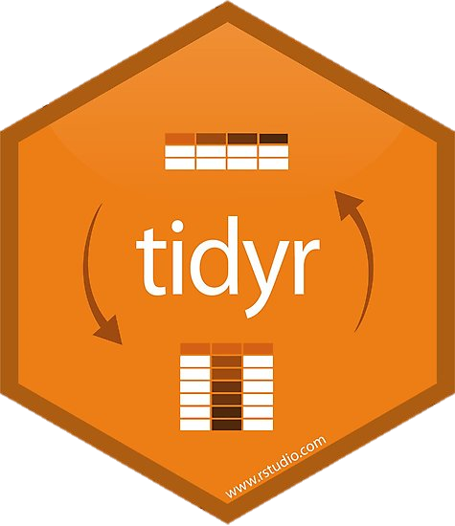




Notes:
We have expanded on our skillset

Slide 12
Thank you to SGSS for supporting this workshop
@beautiful_hack

